Slide 1
Mastering Binocular Vision Evaluations: Practical Techniques and Time-Saving Tips
Benjamin C. Winters, OD, FOVDR

Slide 2
Financial Disclosures
Owner of Emergent VT, LLC that provides Vision Therapy equipment, training, and consulting

Slide 3
Why Screen for Binocular Vision Problems
Example of Grant
Sets You Apart
Parents won't tell you and will keep looking when you don't find it
Offering comprehensive binocular vision screening distinguishes your practice from others
It's the Right Thing to Do
Providing thorough binocular vision evaluation ensures complete patient care

Slide 4
Screening for a Binocular Vision Problem
Save Yourself Time
Checklists for Ages 8-18
You don't have to do near point testing on every patient
Include these in your history for every patient:
Use targeted screening to identify which patients need comprehensive testing
CISS - specific only to the eyes
COVD QOL - Copying from the board, tilting head or closing eye, misaligning digits and columns, clumbiness, poor use of time, short attention span misplace things, forgets things

Slide 5
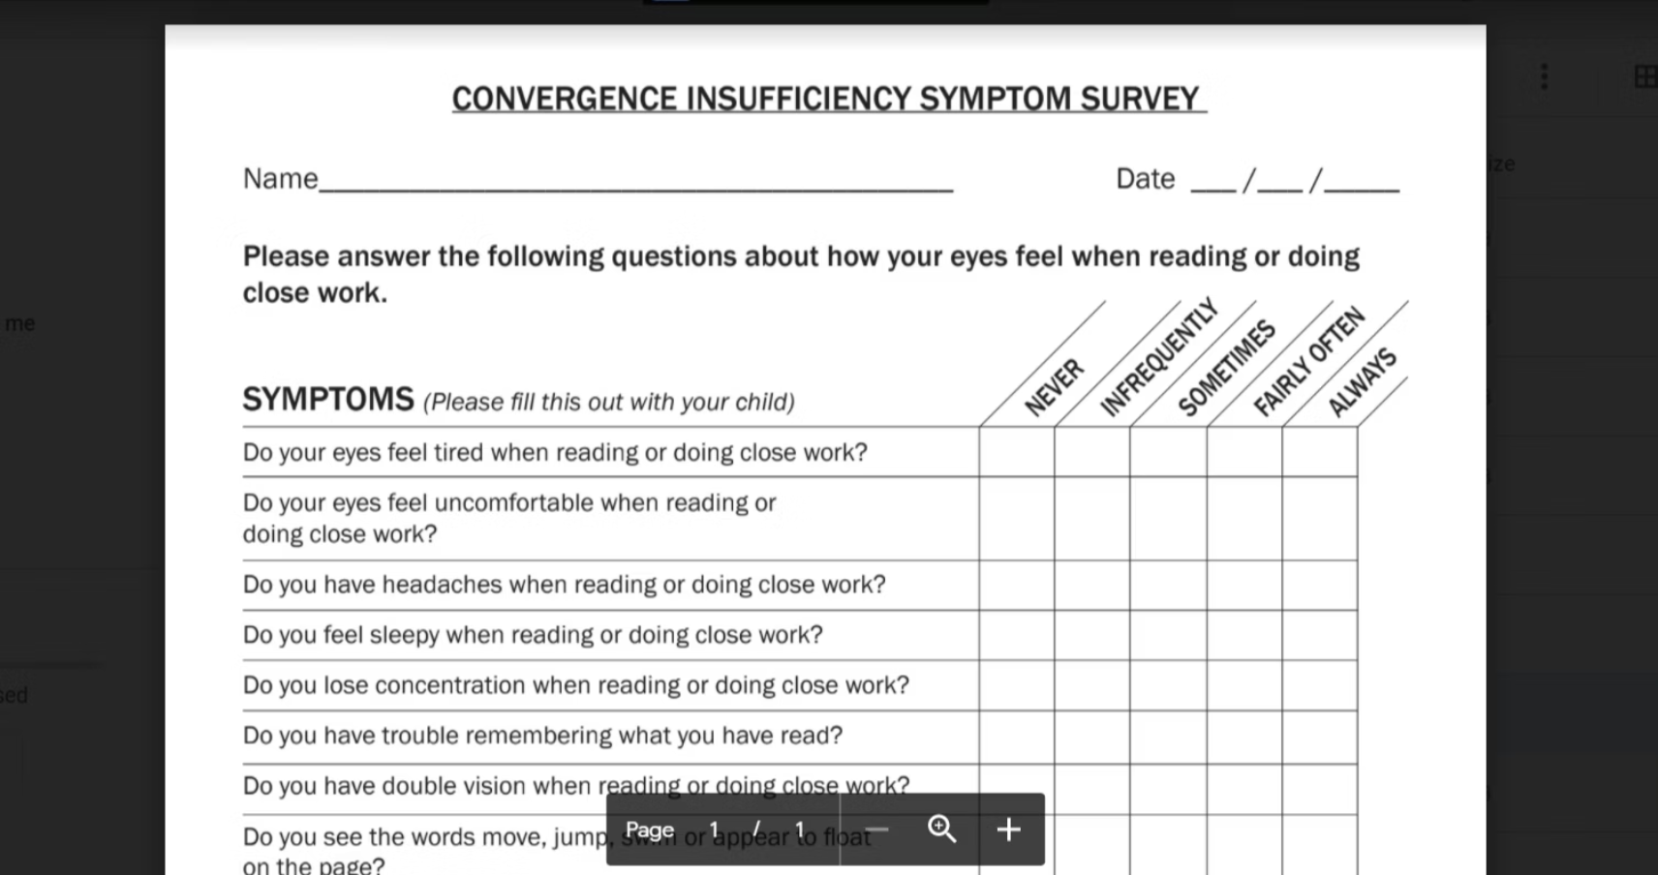

Slide 8
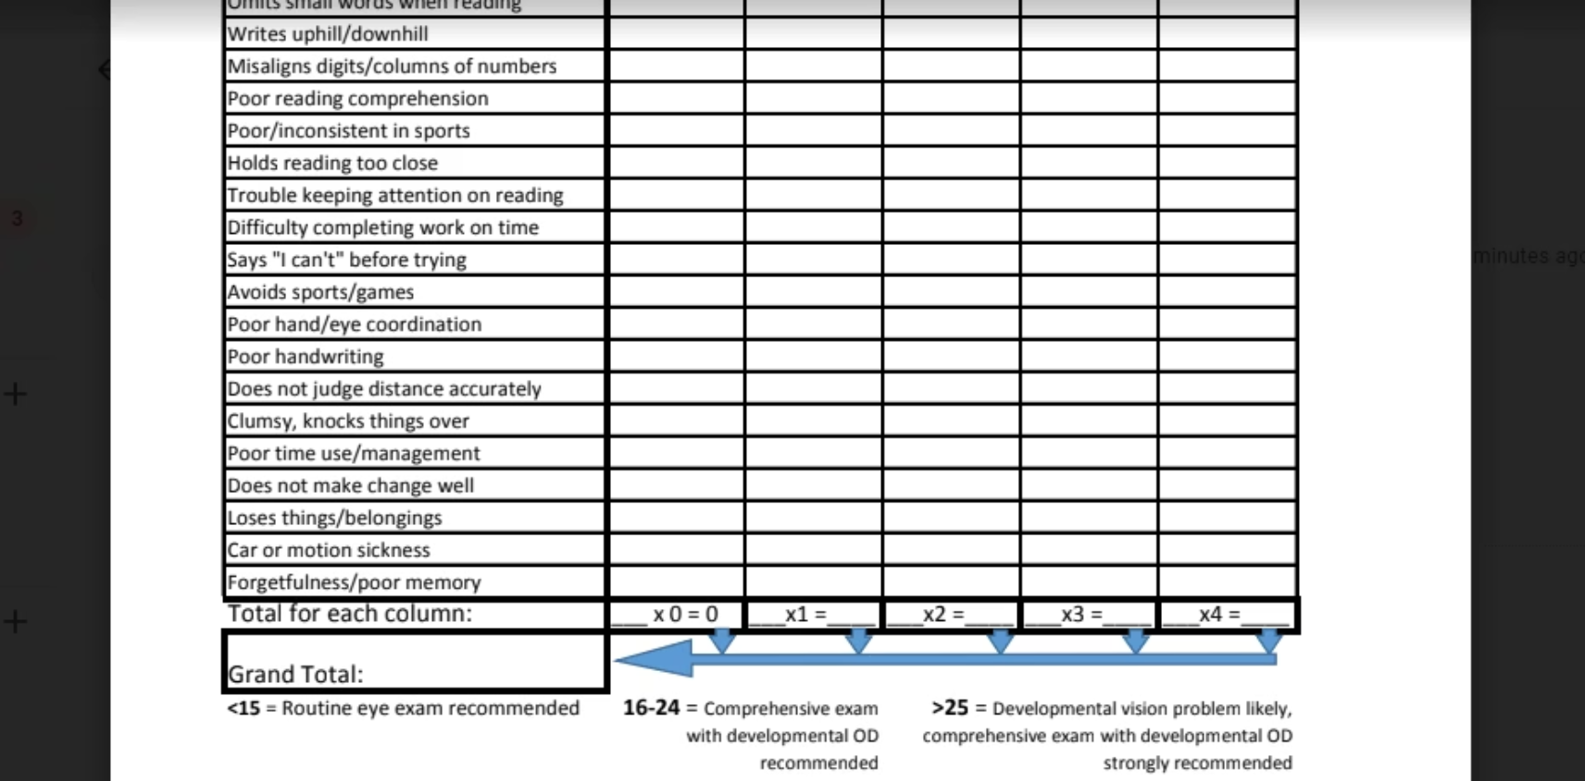
https://www.covd.org/page/QOLSurvey

Slide 9
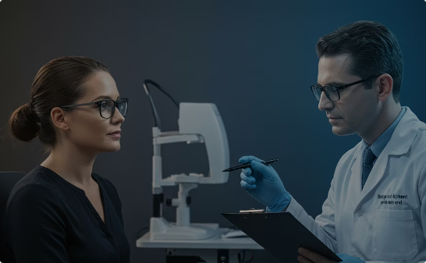
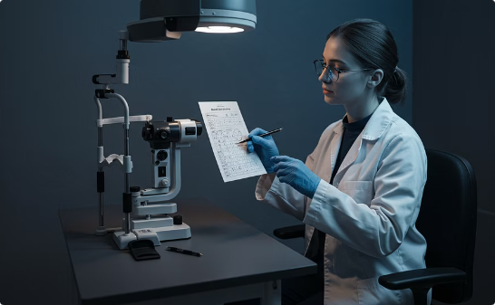
Why Binocular Testing is Important
Determine Why There Are Symptoms
Make a Diagnosis
Establish a Baseline
Establish accurate diagnoses based on comprehensive binocular vision assessment data
Create reference measurements to track changes and evaluate treatment effectiveness over time
Identify the underlying causes of patient complaints like eyestrain, headaches, or reading difficulties

Slide 10
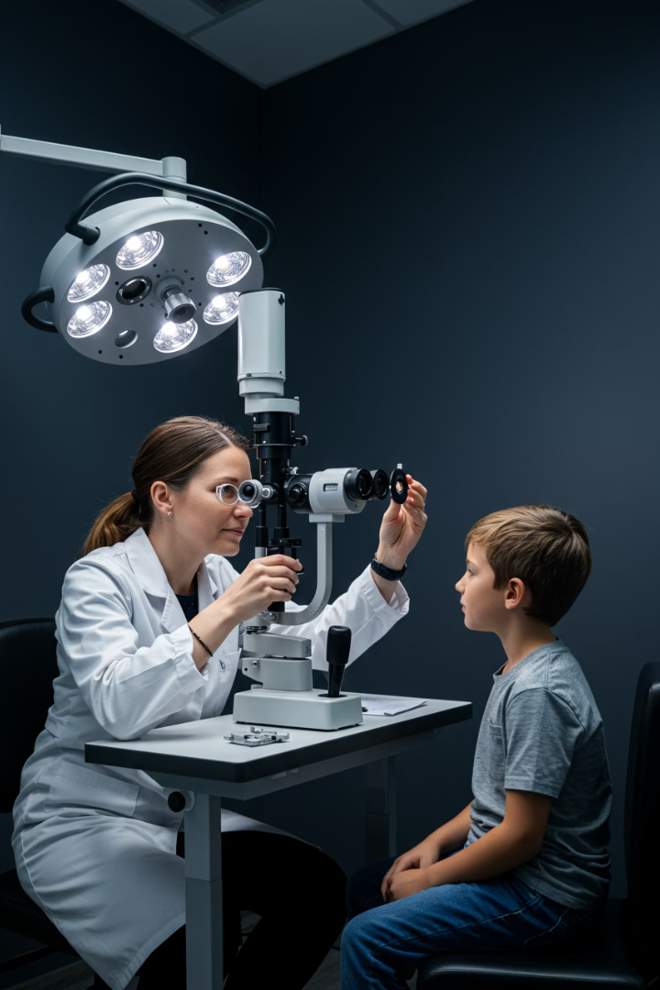
Oculomotor Tests
Why Test Oculomotor Skills
Essential for reading, tracking, and visual processing
Manual Pursuits
Figure 8 - vertical not infinity sign
Very important to watch what happens along the horizontal meridian
NSUCO Scoring
Northeastern State University College of Optometry
Standardized/most well known with age-based norms
Pursuit Severity Scale
Trace, mild, moderate, severe
Communicates nicely to other professionals
Less burdensome (No age based norms). These should all be none by age 7

Slide 11
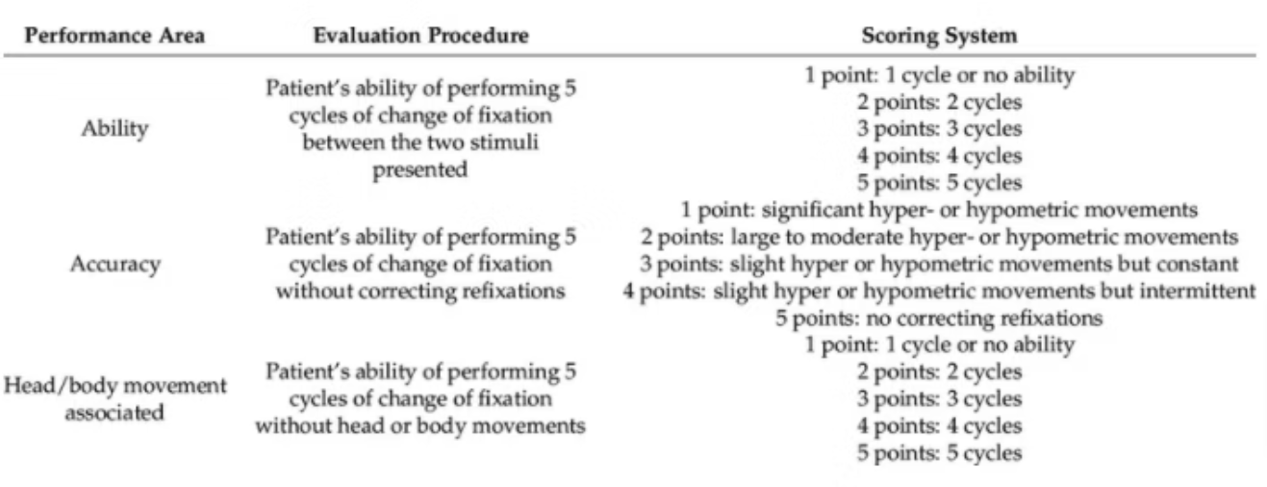
NSUCO Pursuit Scoring

Slide 13
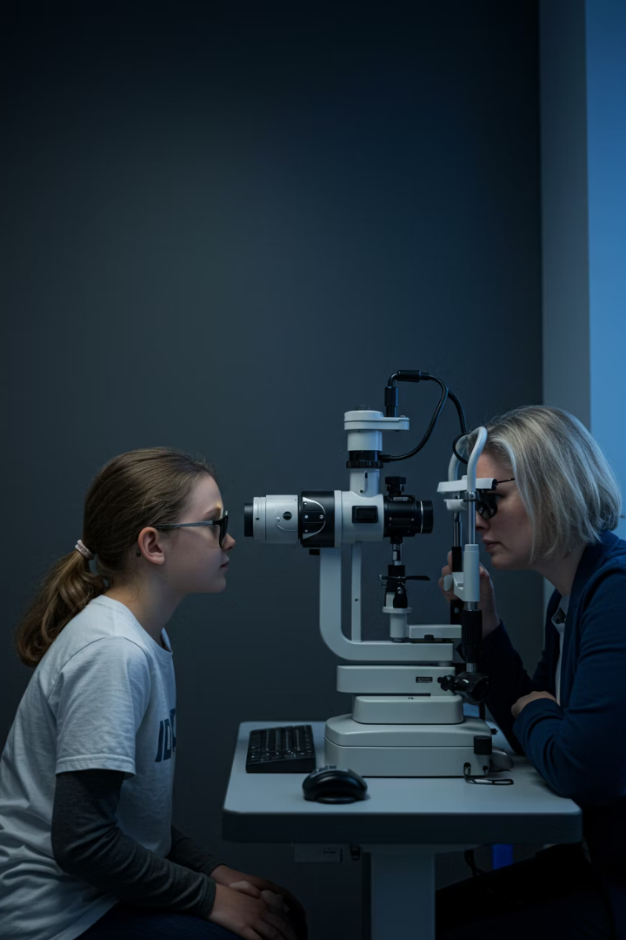
Manual Saccades and Fixation
How to Perform Saccades Test
30 degrees or less - no head movement is normal
30-60 degrees normal to have head movement
Greater than 60 degrees normal to have head and body movement
Switch should be off cadence
Horizontal, vertical, oblique
Saccadic Severity Scale
Documentation of head movement and accuracy
NSUCO Saccadic Test
Normal - find age based norms by searching online
Manual Fixation
With a peripheral stimulation
Documentation of stability and maintenance

Slide 14
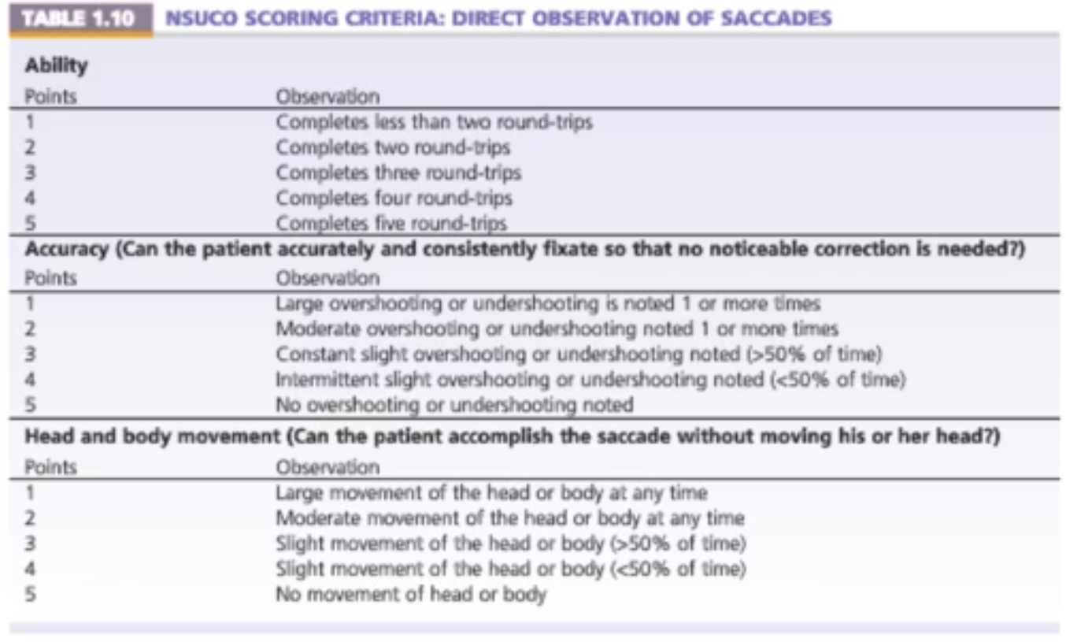

Slide 17
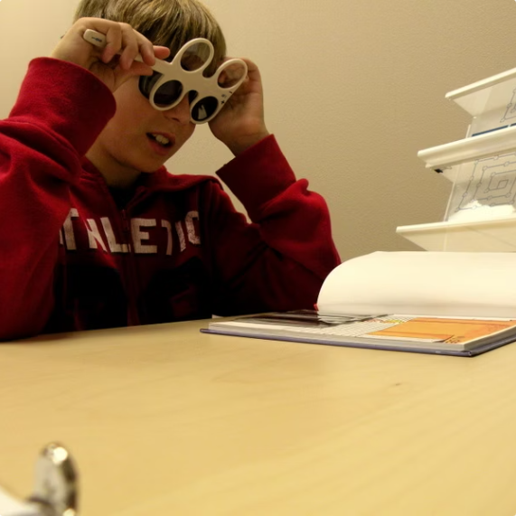
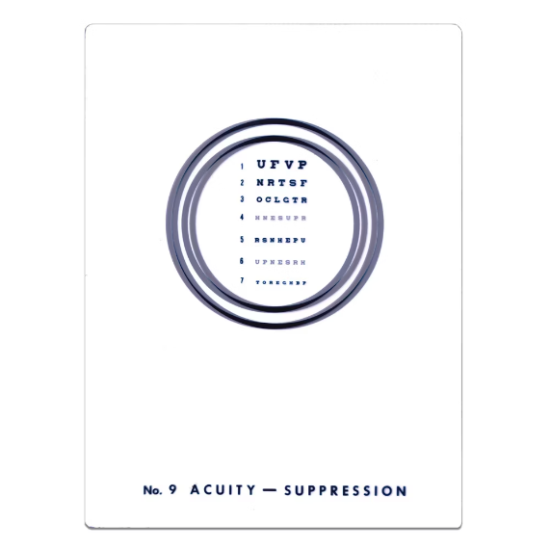
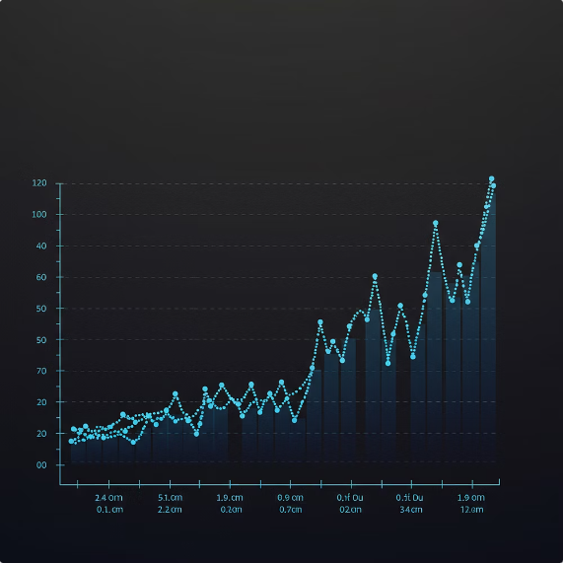
Tests of Accommodation
Cycles per Minute Method
Seconds of Lag Technique
Normal vs Optimal
+/-2.00 lenses at 40cm, monocular then binocular for 1 minute
Use Vectogram #9 with polaroid glasses
Monocular norm: 11 cycles/min or 1.72 seconds lag
Binocular norm: 8 cycles/min or 2.75 seconds lag
Optimal: Monocular = 1 second lag, Binocular = 1.5-2 seconds lag
The seconds to lag method is easier to administer - you can talk to the patient and make observations. It's also much faster than the traditional cycles per minute approach.

Slide 20
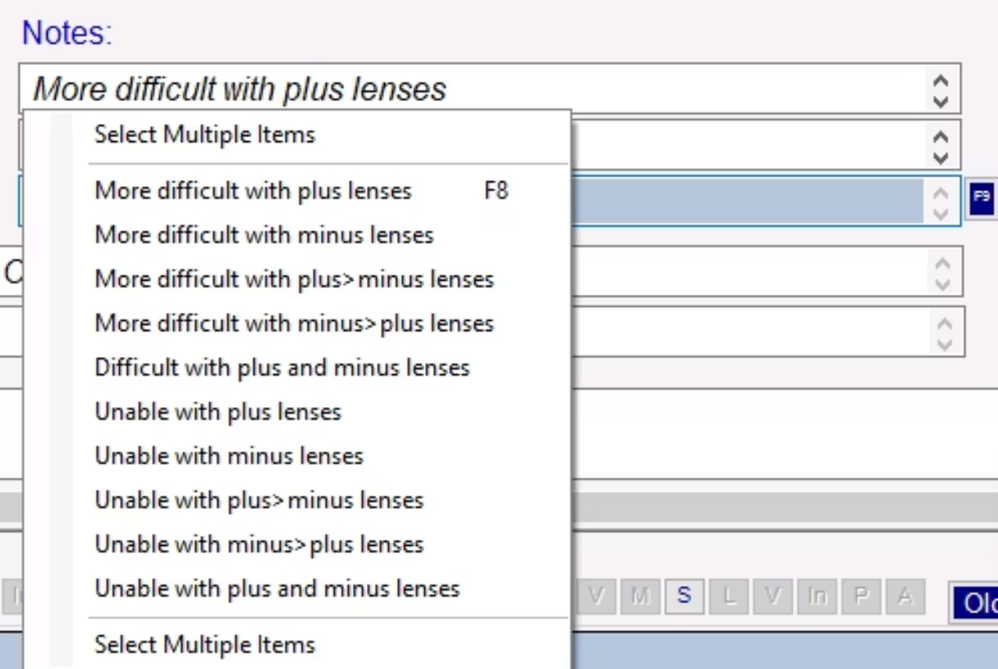

Slide 21
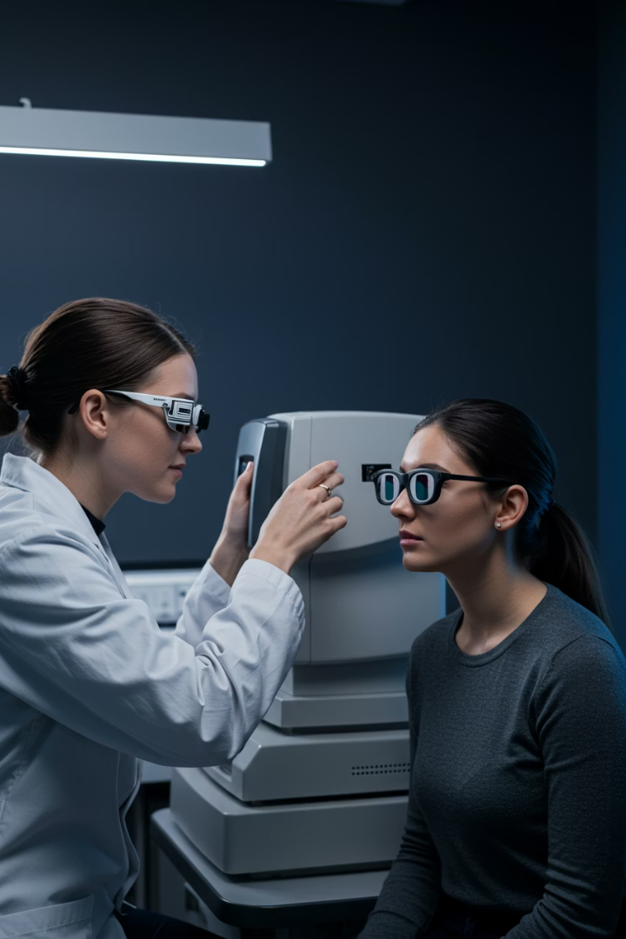
Tests of Binocularity
Stereopsis
3 main reasons: Strabismus check, measure progress, document safety concern
Types: Local (Wirt Circles), Randot, Global, Distance stereo
Document level, which ones missed, when they slowed

Slide 22
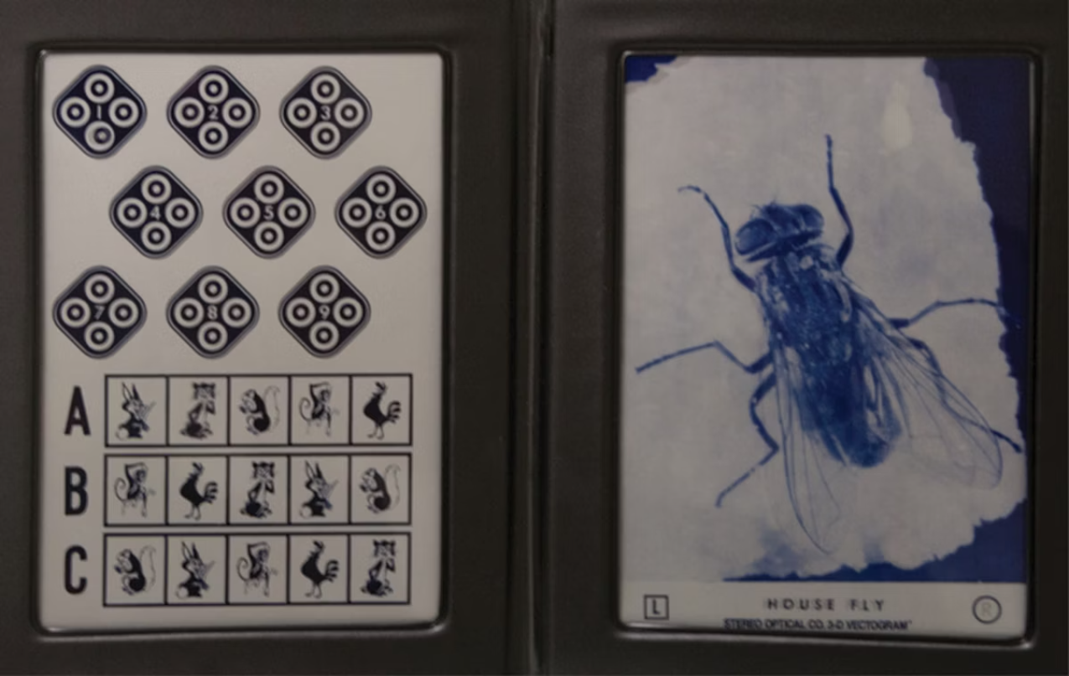
Local - Wirt Circles

Slide 23
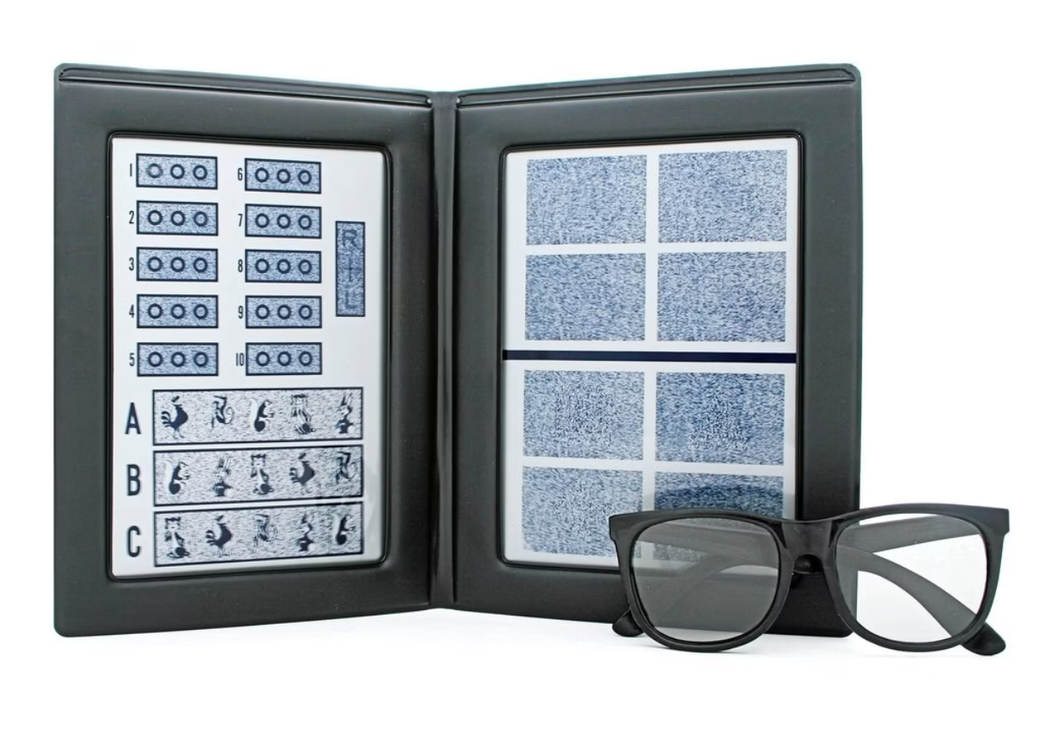
Randot

Slide 24
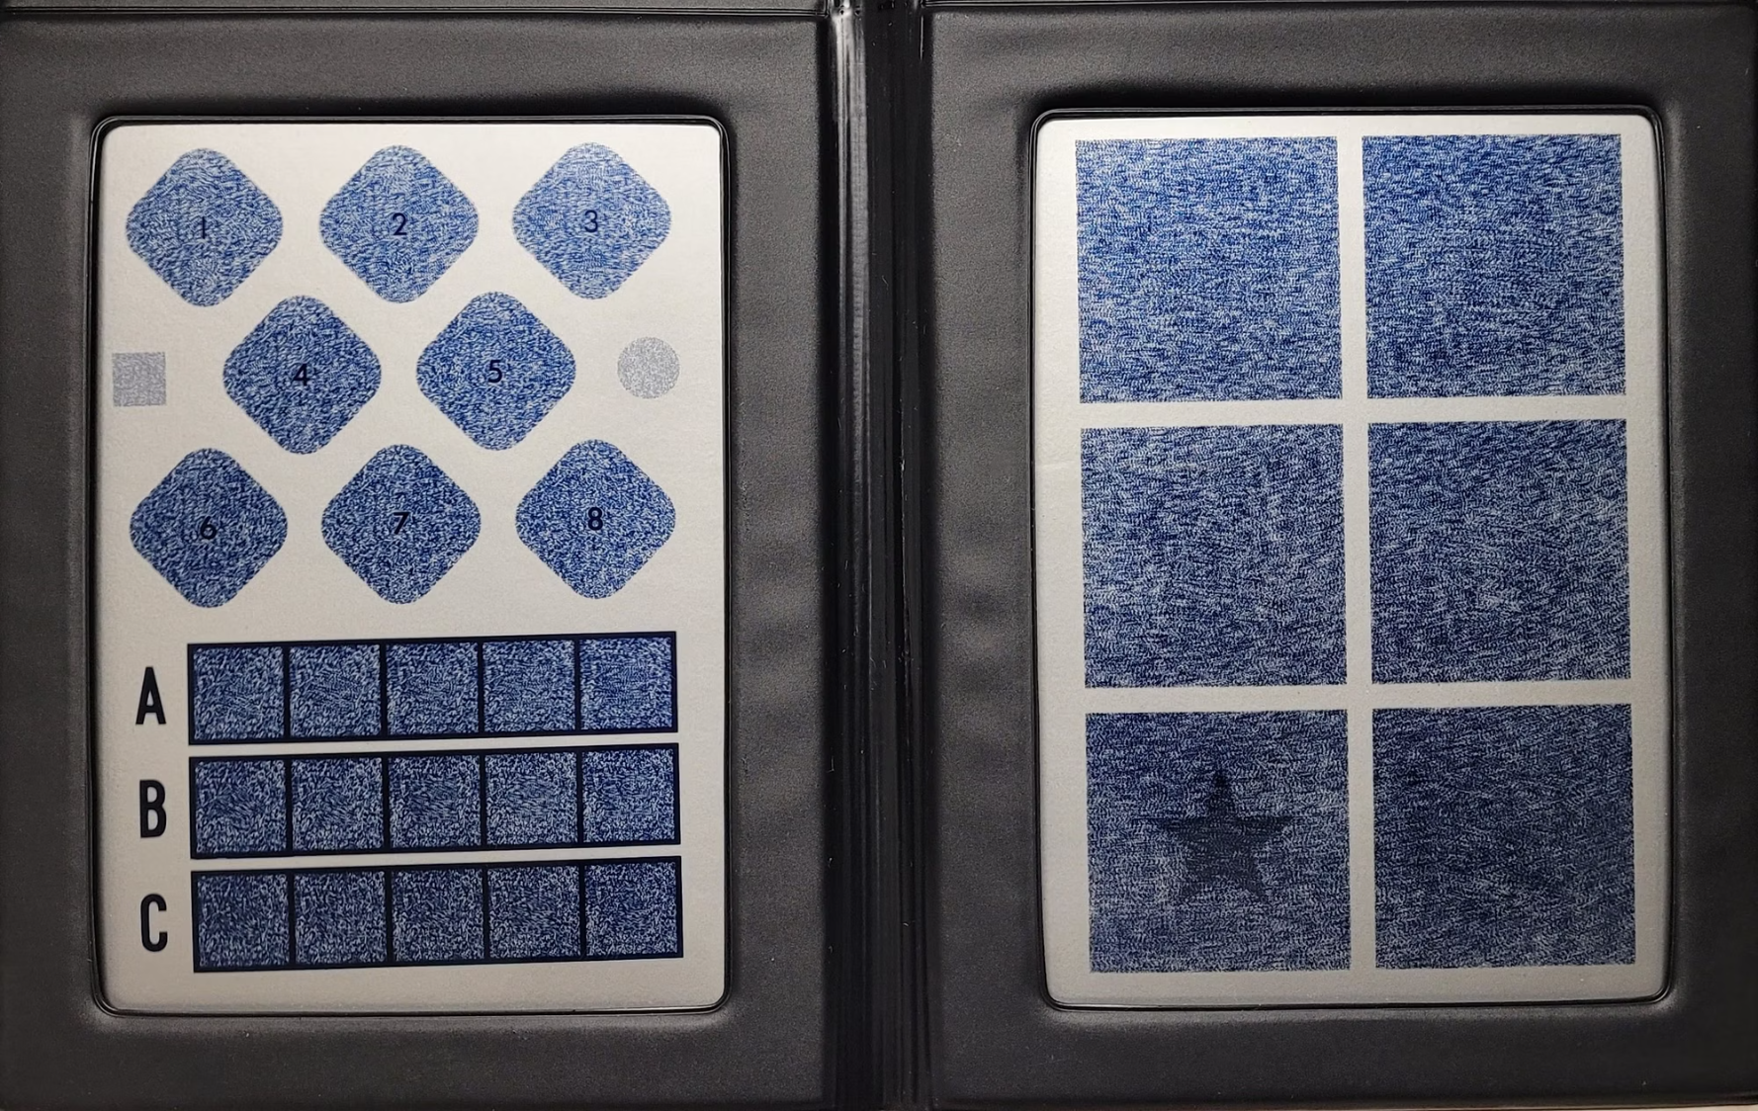
True Randot

Slide 25
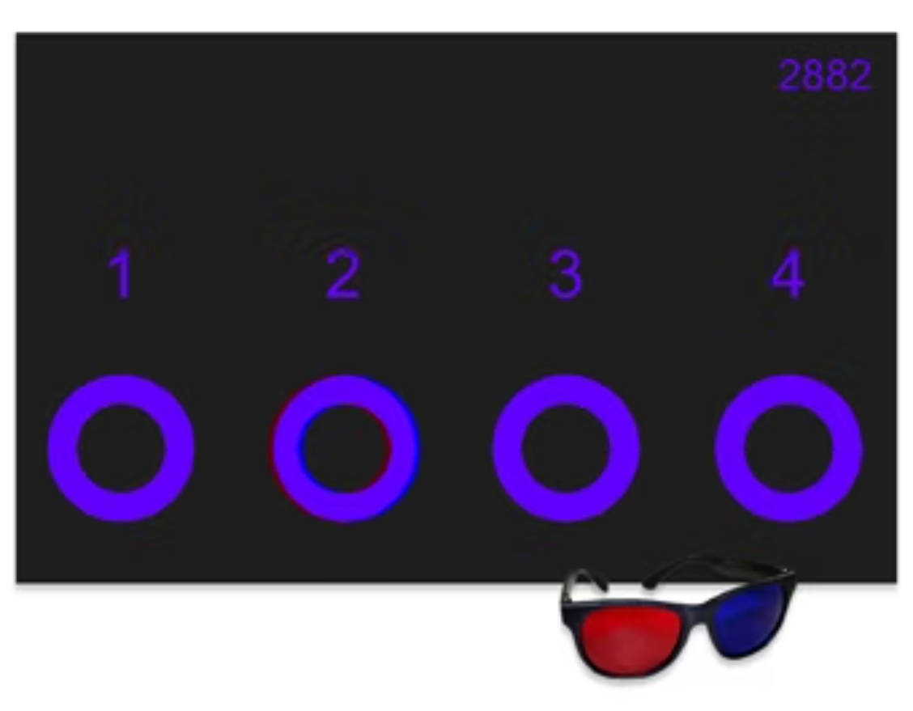
Distance Stereopsis

Slide 27
Tests of Binocularity
Cover Test
Target: Two lines larger than best corrected VA
Occluder: Opaque and translucent
Document: Phoria, Tropia (intermittent/constant, alternating/eye, XT or ET)
Pearls: Neutralizing prism, estimated measure, % aligned

Slide 28
Tests of Binocularity
NPC and Red Lens NPC
Normal: NPC - 5/7 cm = ⅔ in, Red Lens NPC - 7/10 cm = ¾ in
Document: Point of discomfort, break, recovery, OD/OS out
Red Lens: Not a better test, different test - another baseline for Strabismus, TBI

Slide 29
Tests of Binocularity
Worth 4 Dot
Check for suppression or diplopia
Ask what color they see
Great for demonstration to parents

Slide 30
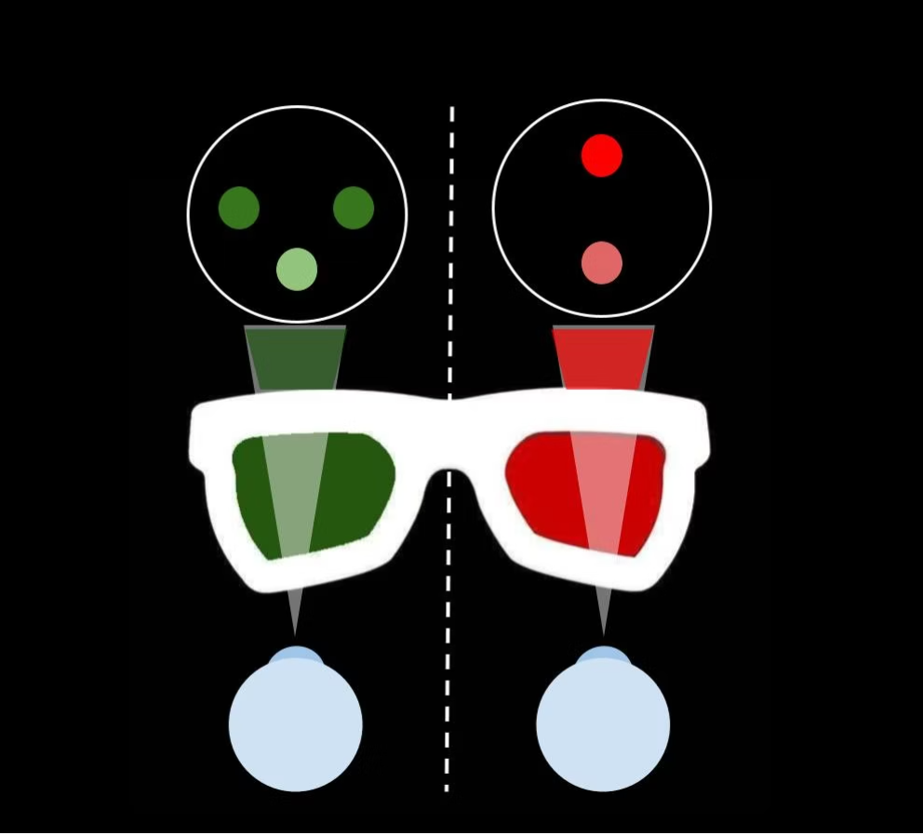
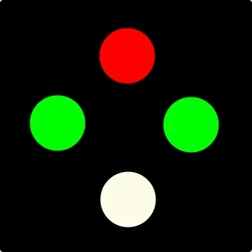

Slide 32
So, You've Diagnosed a Binocular Vision Problem, Now what?

Slide 33
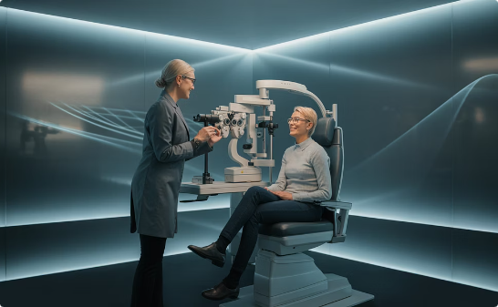
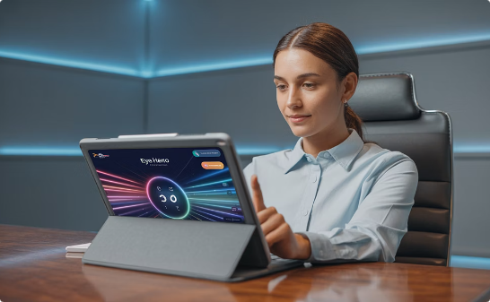
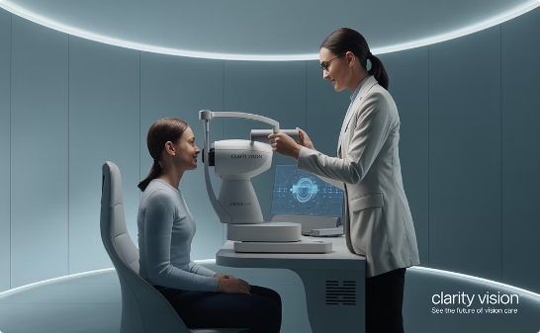
Options
Refer to an optometrist who specializes in VT
Use Eye Hero or other similar program
Start some simple VT in your clinic
Professional vision therapy with specialized equipment and techniques
Digital vision therapy solutions for at-home practice
Incorporate basic vision therapy techniques into your practice

Slide 34
Where to Learn More
Emergent's Advanced Vision Therapy Course
Email: drwinters@emergentvt.com

